Slide 1
IIT Madras Computer Centre
P.G. Senapathy Centre for Computing Resources
STAGE 1 – DDOS MITIGATION

Slide 2
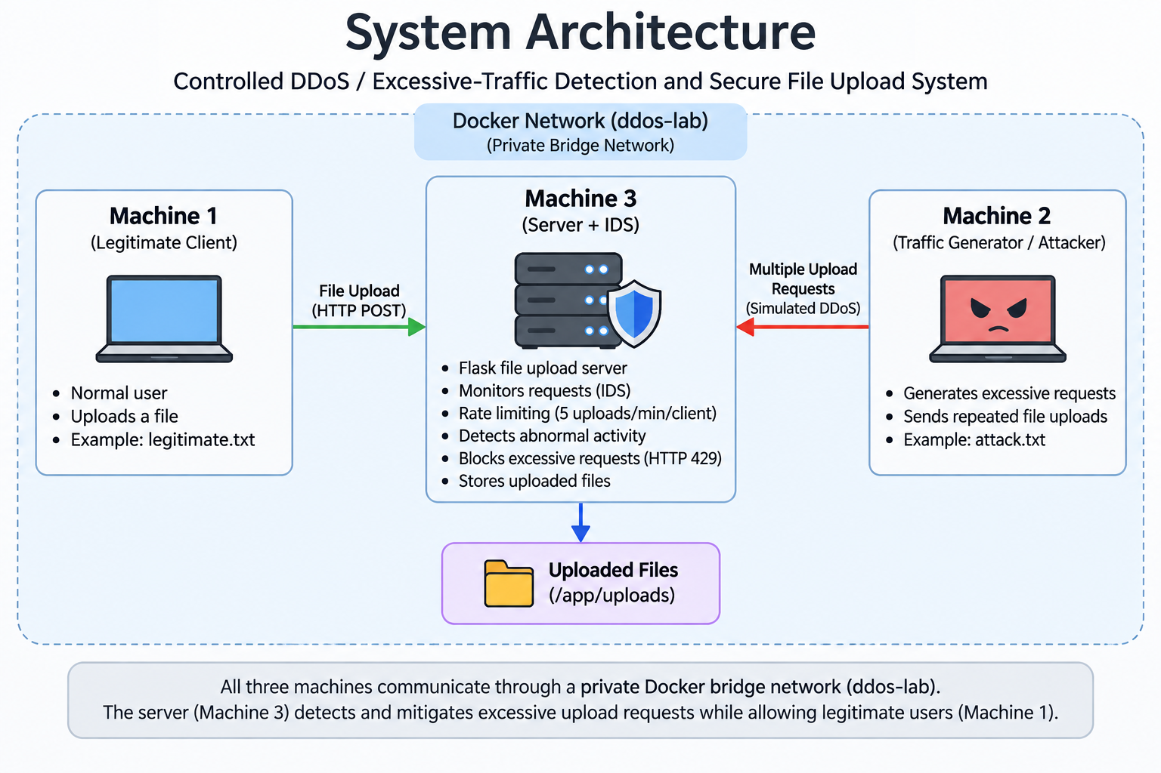

Slide 3
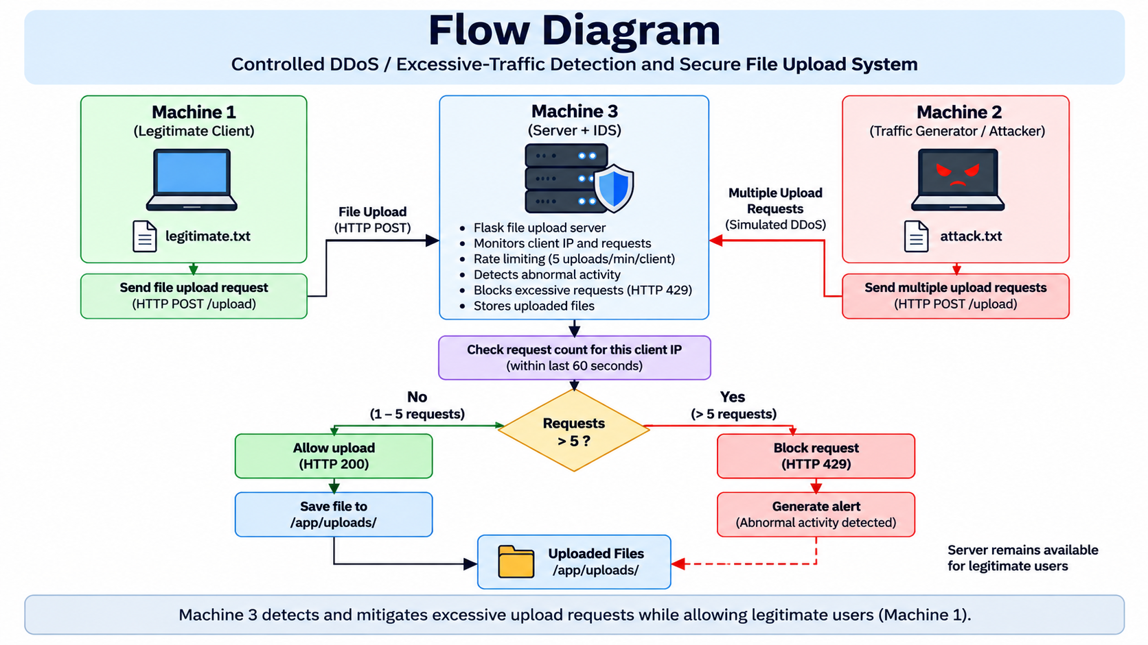

Slide 4
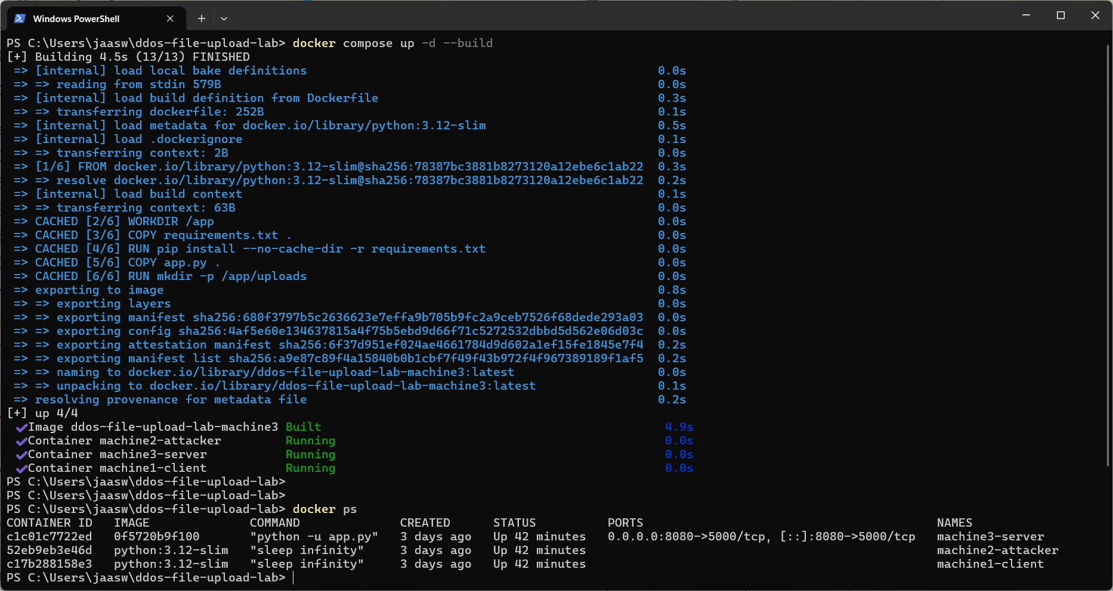
Docker Deployment
docker compose up -d --build → image built → three containers running

Slide 5
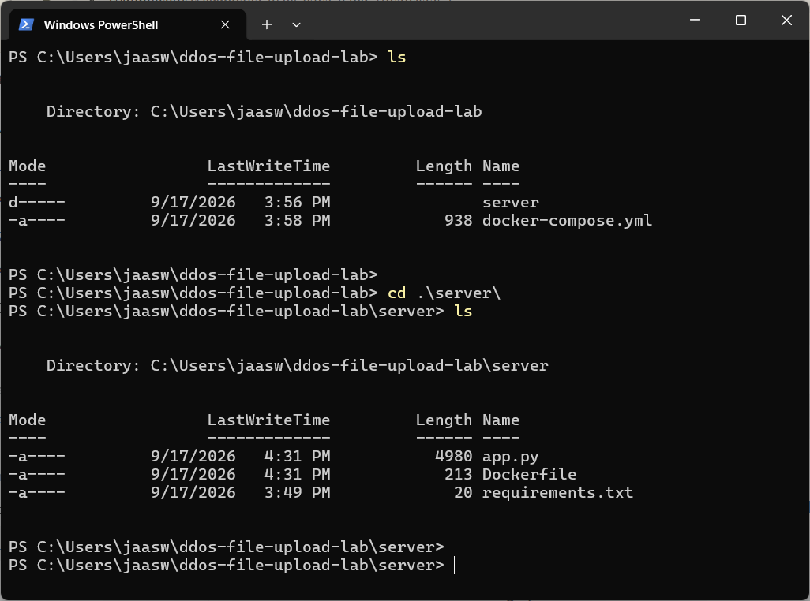
Project Structure
docker-compose.yml → environment | app.py → server + IDS | Dockerfile → server image | requirements.txt → dependencies

Slide 6
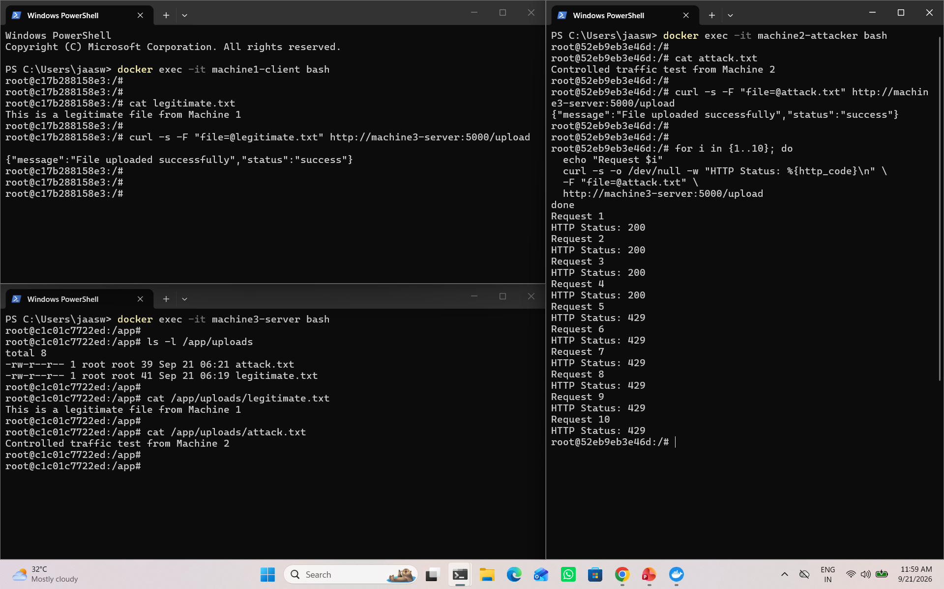
Test - Controlled Excessive Traffic
Controlled test command
Machine 2 ( Server )
Machine 1 ( client )
for i in {1..10}; do
echo "Request $i"
curl -s -o /dev/null -w "HTTP Status: %{http_code}\n" \
-F "file=@attack.txt" \
http://machine3-server:5000/upload
done
Requests 1–5
HTTP 200
Machine 3 ( attacker )
Requests 6–10
HTTP 429
Controlled traffic is confined to the private Docker lab.

Slide 7
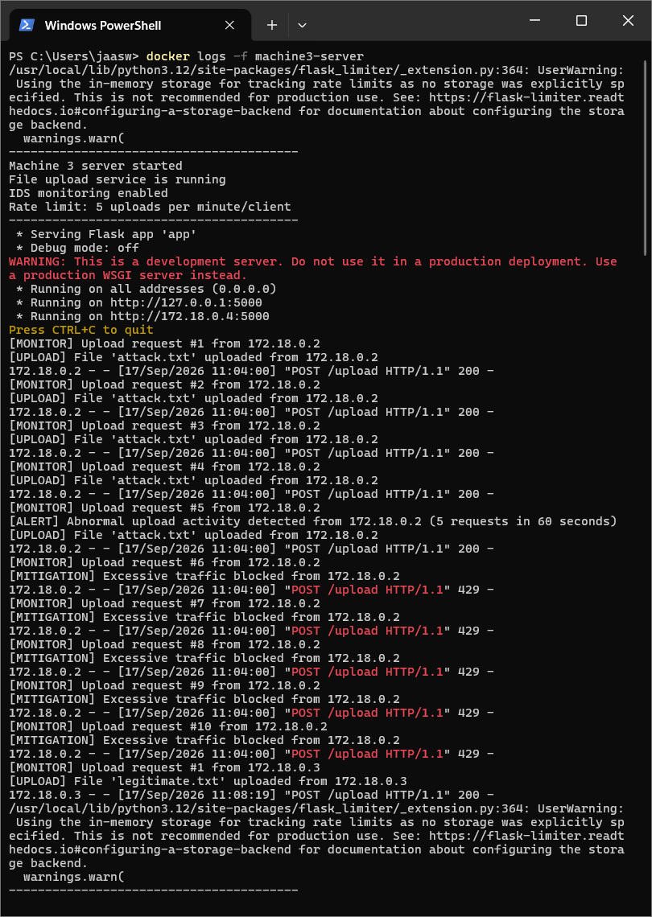
Test — IDS Alert and Mitigation Logs
Key evidence: [ALERT] at request 5 and [MITIGATION] from request 6 onward.
Before
Machine 2 sends excessive requests.
Requests beyond the limit are blocked.
After
Machine 1 sends legitimate.txt.
Result
HTTP 200 — legitimate upload succeeds.
Service remains available

Slide 8
